Slide 1
Text Mining using Python
Kathirmani Sukumar

Slide 2
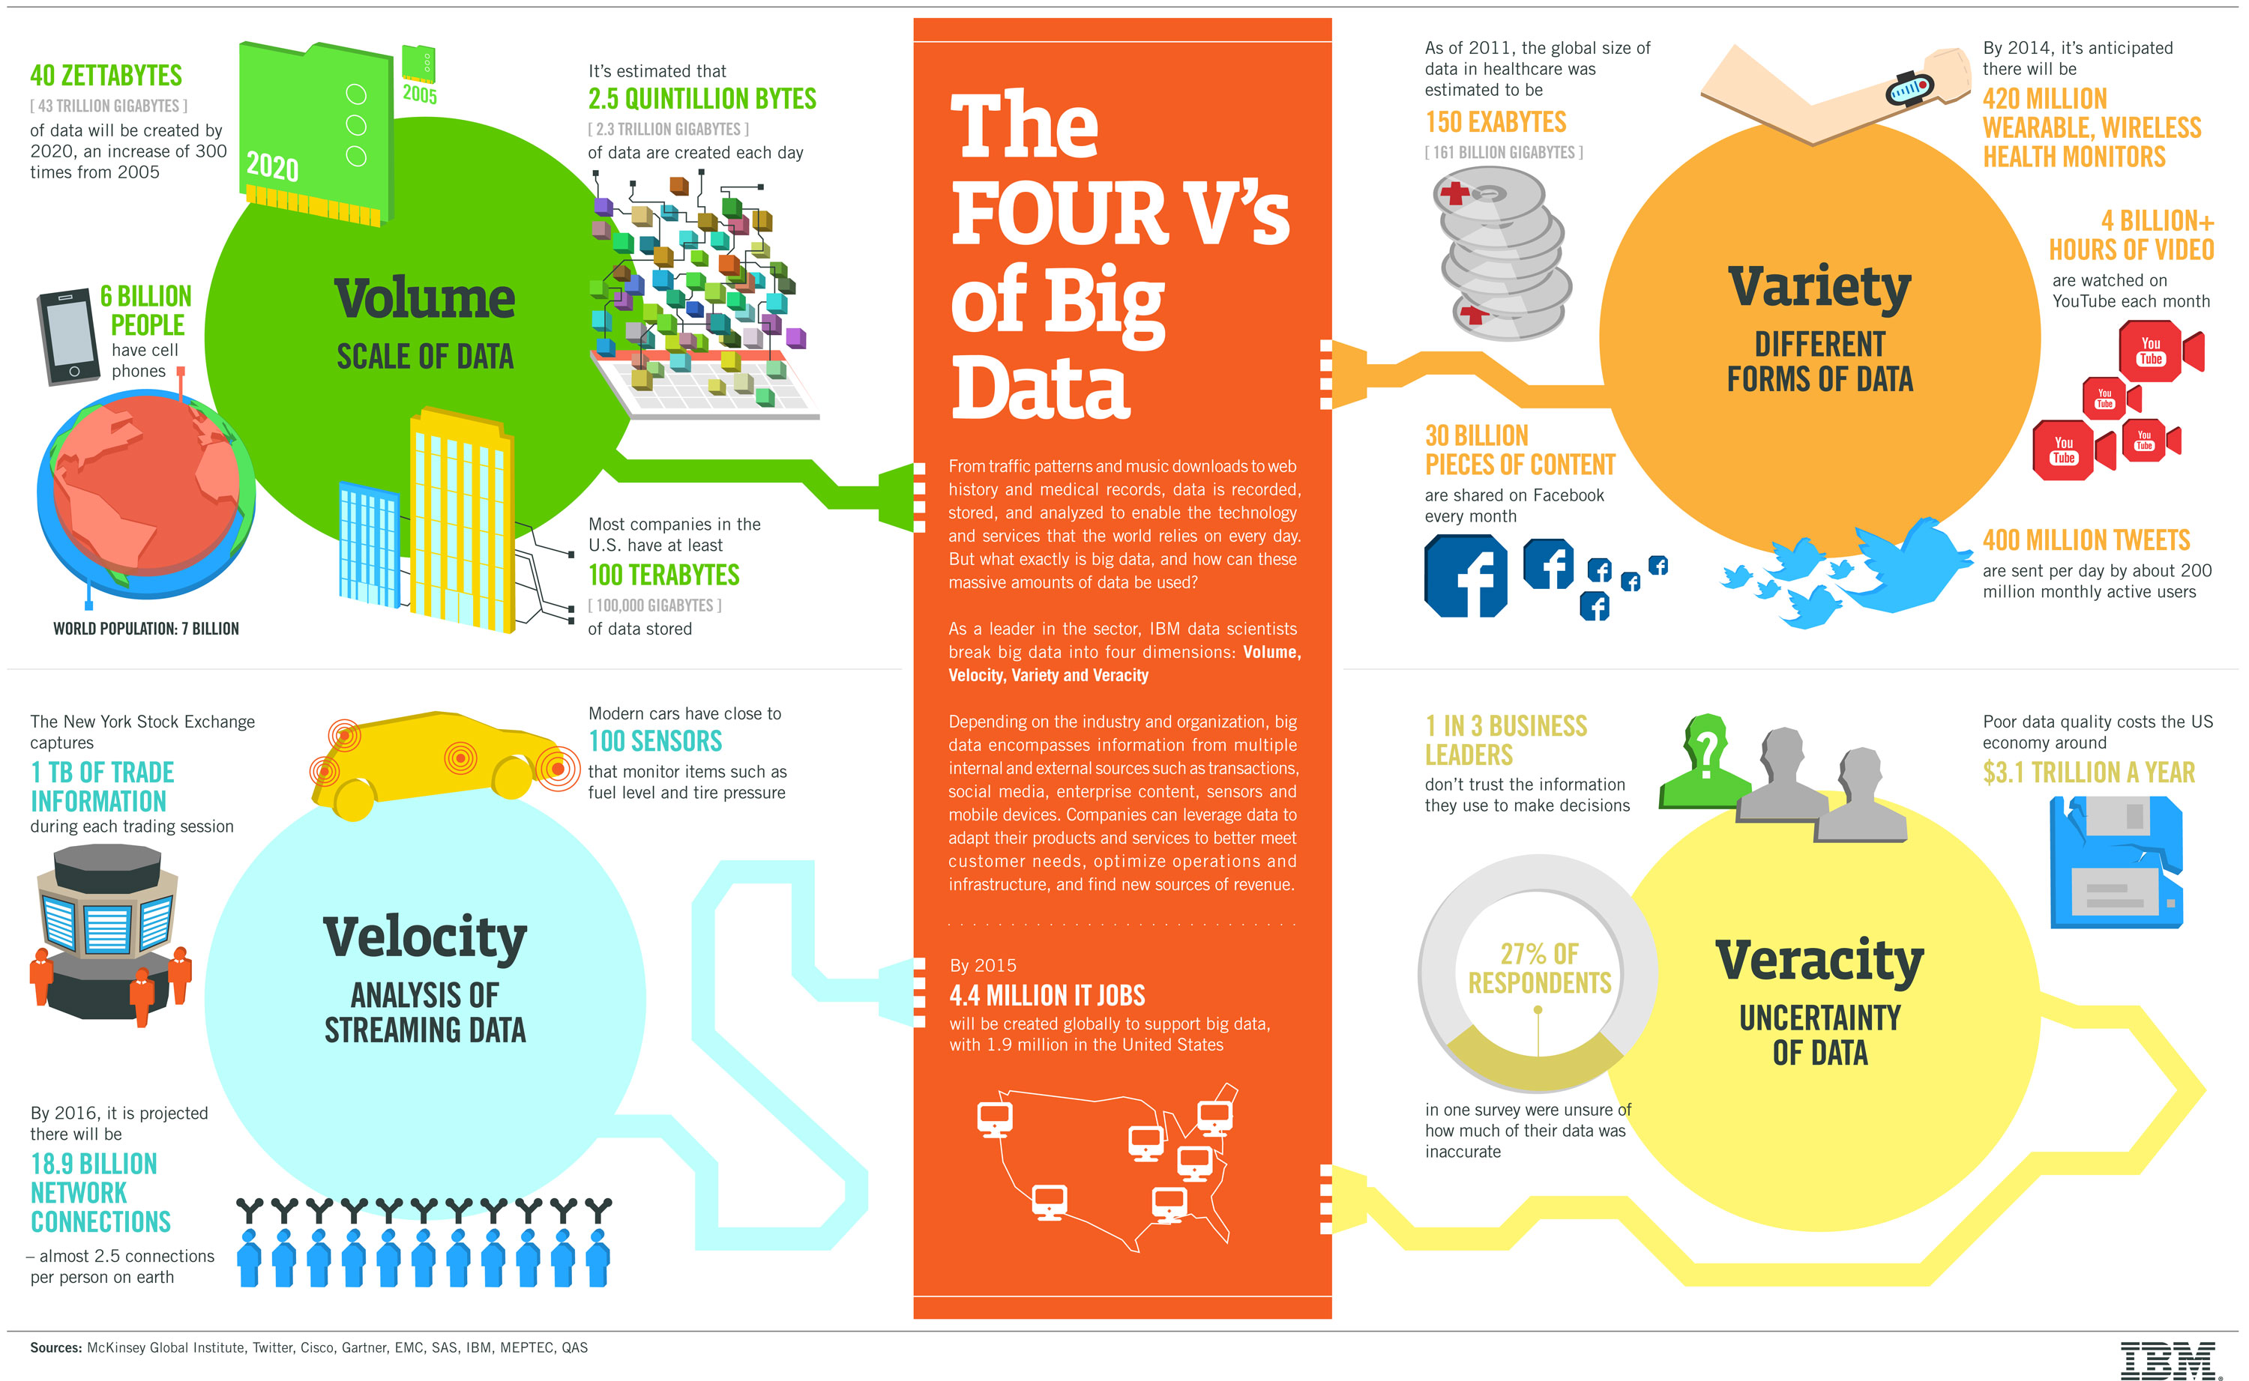
Need for Text Analytics

Slide 3
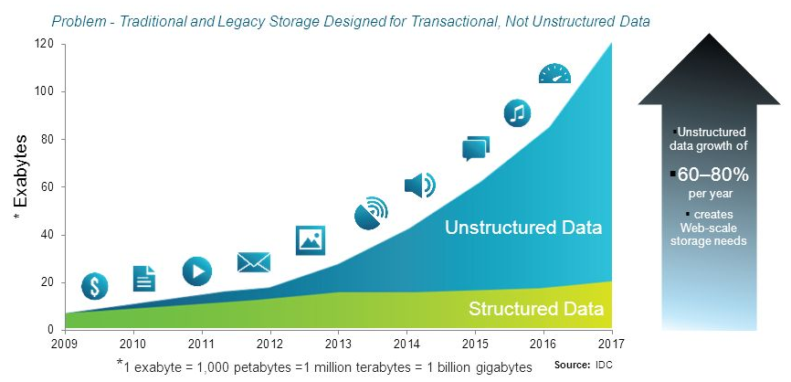
Growth of Unstructured Data
In 1998, Merrill Lynch cited a rule of thumb that somewhere around 80-90% of all potentially usable business information may originate in unstructured form.
Data Growth
IDC and EMC project that data will grow to 40 zettabytes by 2020.
Resulting in a 50-fold growth from the beginning of 2010.
Computer World states that unstructured information might account for more than 70%–80% of all data in organizations.

Slide 4
Types
Documents
Memos, research papers, articles
Email conversations
Multimedia content
Audio, Video, Images
HTML
Web chat, blogs, web pages
Forms & Feedback
SMS

Slide 5
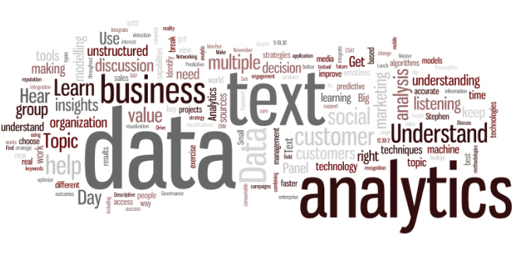
Text Analytics Applications
Customer experience management
Brand monitoring
Understanding sentiments and buzz
Digital research
Relationship identifications
HR Analytics
Infrastructure management
Media content management
Search engines
…..

Slide 6
Text Analytics Case studies

Slide 7
Challenges
Defining a structure to store
Recognizing text from images, scanned documents, especially handwritten documents
Informal languages, typos, abbreviations, short messages
Polysemy - the coexistence of many possible meanings for a word or phrase
No definite answers
Need for high end systems to handle huge volume of data
Identifying people with correct skillsets

Slide 8
Challenges…
Easy for humans, hard for machine
Highly redundant data
Huge amount of data to be processed
High dimensionality
Large number of features
Abstract ideas hard to represent

Slide 9
Techniques
Text Analytics
Summarization
Feature Extraction
Text Categorization
Sentiment Analysis
Document classification
Topic Modelling
Relationship Identification

Slide 10
Data Sources
Twitter, Facebook APIs
Email logs
Minutes of Meeting
Board resolutions
Frequently asked questions
Recordings
Blogs, websites
…

Slide 11
Packages in R
nltk
gensim
Spacy
TextBlob
Scikit-Learn
…

Slide 12
References
Natural Language Toolkit - http://www.nltk.org
Standford NLP - https://nlp.stanford.edu
Latent Dirichlet Allocation Using Gibbs Sampling – Ethen Liu
Gensim – Topic modelling for Humans
Vector representation of Words – Tensorflow documentation

